Slide 1
DETECTION OF ALZHEIMER'S DISEASE
BY
YASHAS S
ANAGHA P
SAGAR NAIK
RANJAN KUMAR A

Slide 2
Introduction

Slide 3
Alzheimer's disease is a progressive neurologic disorder that causes the brain to shrink and brain cells to die.
Alzheimer's disease is the most common cause of dementia.
Alzheimer disease are of 2 stages:Mild cognitive impairment(MCI) and Alzheimer dementia(AD).

Slide 4
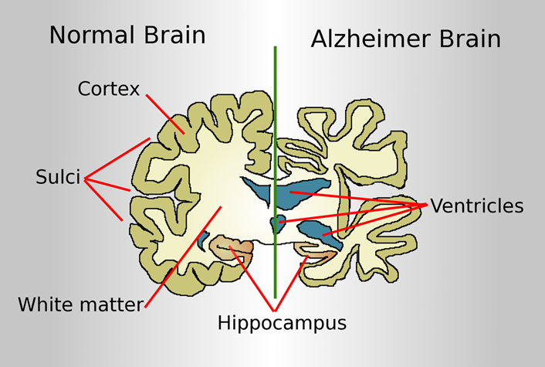

Slide 5
Tools
Registered in ADNI Website and Downloaded the data of MRI Images.(.nii files)
MRI cro tool is used for visualization of MRI images
MATLAB SPM 8 tool is used for segmentation

Slide 6
After segmentation we get white matter, gray matter and csv files.Only Gray matter is used for feature extraction.
Gray matter image will be converted to binary data using 2DWT (csv file).
PySpark

Slide 7
Machine Learning
Machine Learning provides systems the ability to automatically learn and improve from experience without being explicitly programmed.

Slide 8
Logistic regression
Logistic regression is a supervised learning classification algorithm used to predict the probability of a target variable.
Logistic Regression performs well when the dataset is linearly separable.
The nature of target or dependent variable is dichotomous, which means there would be only two possible classes.

Slide 9
HADOOP

Slide 10
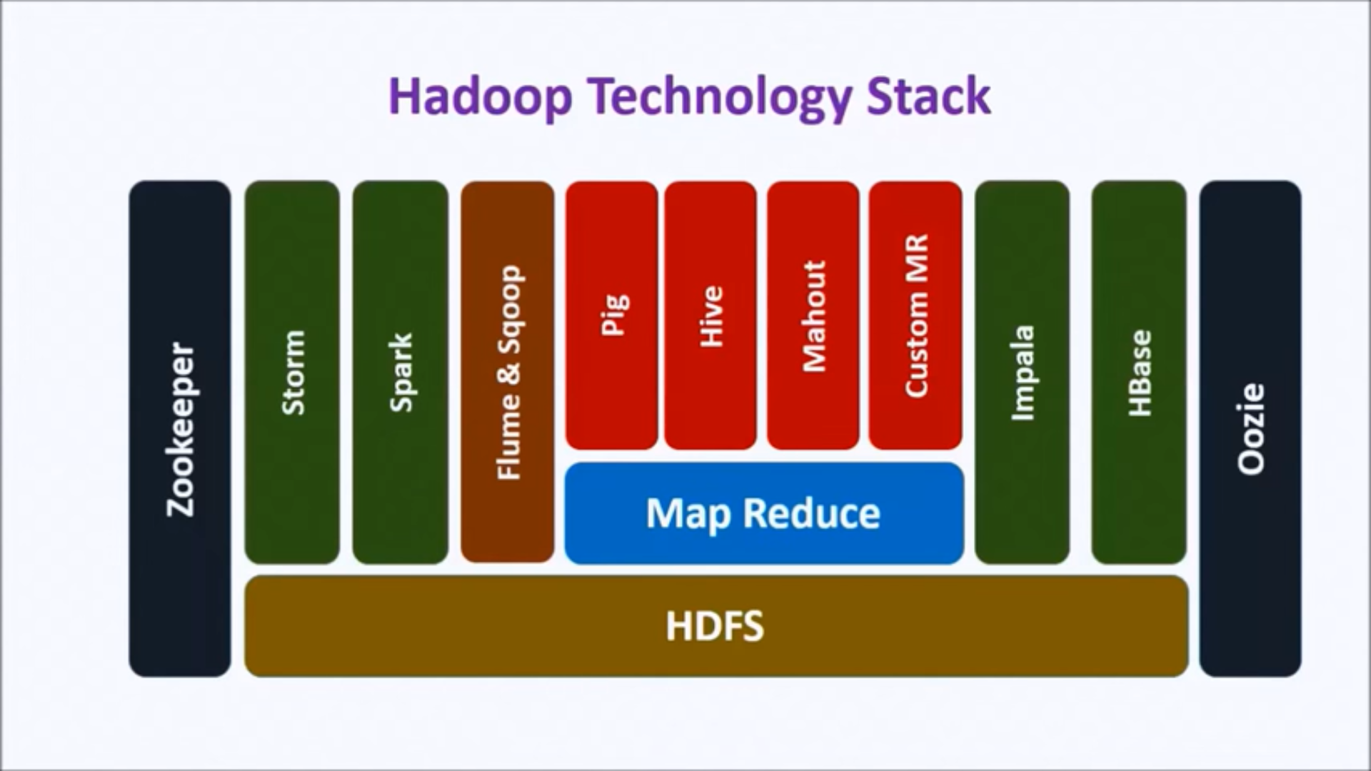

Slide 11
SPARK

Slide 12
A fast and general engine for large-scale data processing.
Open-source cluster computing framework.
Developed to overcome limitations of Hadoop/ MapReduce.
Runs from a single desktop or a huge cluster.
Iterative,interactive or stream processing.
Supports Multiple languages - Python , Scala, R , Java.
Many times faster than mapreduce.
Multiple Options and libraries - Graph, SQL, ML, Streaming etc.

Slide 13
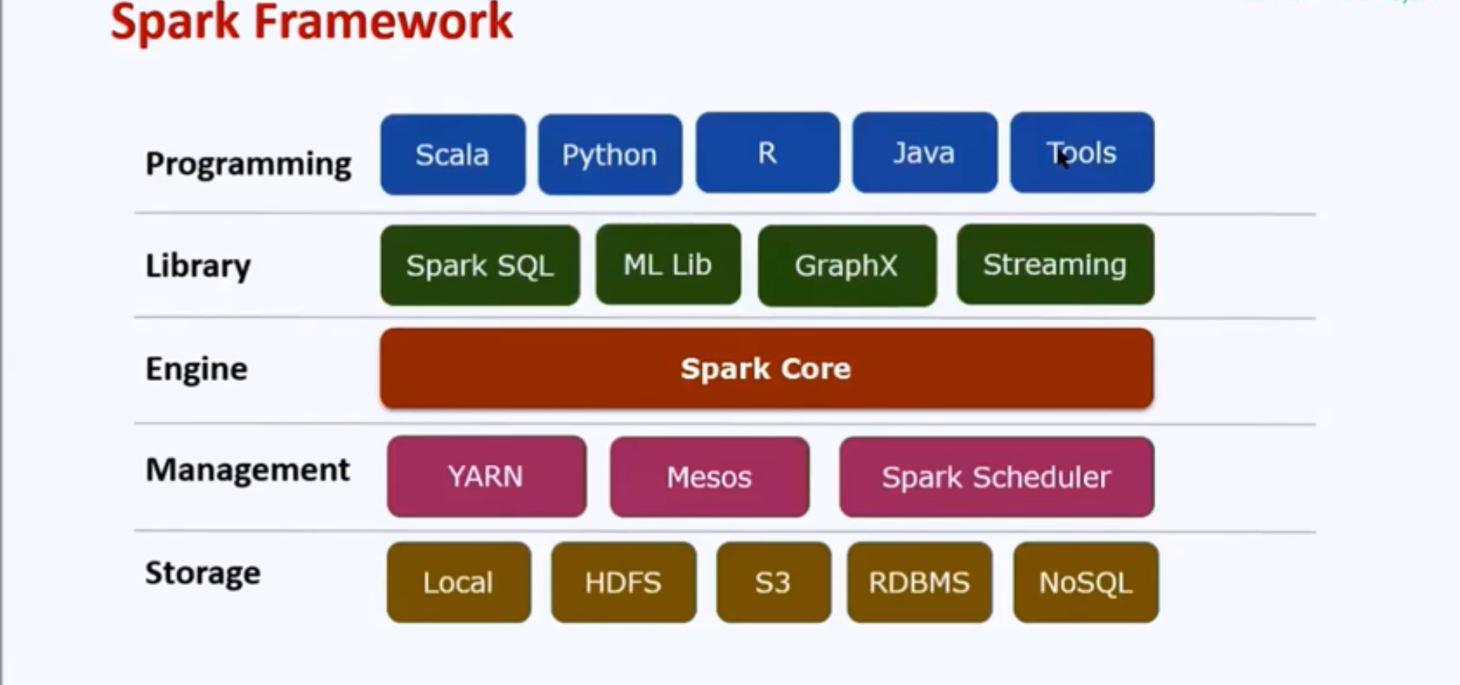
Spark Architecture

Slide 14
Resilient Distributed Datasets(RDD)
Spark is build around RDDs. We create, transform, analyze and store RDD in a Spark program.
The Dataset contains a collection of elements of any type.
The dataset can be partitioned and distributed across multiple nodes
RDDs are immutable. They can’t be changed
They can be cached and persisted
Transformations act on TDDs to create new RDD

Slide 15
Lazy Evaluation
Lazy evaluation means Spark will not load or transform data unless an actions is performed
1. Load file into RDD
2. Filter the RDD
3. Count no. of elements(only now loading and filtering happens)
Helps internally optimize operations and resource usage

Slide 16
Vector assembler
StringIndexer encodes a string column of labels to a column of label indices. If the input column is numeric, we cast it to string and index the string values. The indices are in [0, numLabels).
VectorAssembler is a transformer that combines a given list of columns into a single vector column.
It is useful for combining raw features and features generated by different feature transformers into a single feature vector, in order to train ML models like logistic regression and decision trees.
CODE: class pyspark.ml.feature.VectorAssembler(inputCols=None, outputCol=None, handleInvalid=’error’):

Slide 17
Training and Testing Data
Historical Data contains both predictors and outcomes
Split as training and testing data
Training data is used to build the model
Testing data is used to test the model
Apply model on training data
Predict the outcome
Compare the outcome with the actual value
Measure accuracy
Training and Test fit best practices
70:30 split
Random selection of records.Should maintain data spread in both datasets.

Slide 18
THANK YOU

